Slide 1
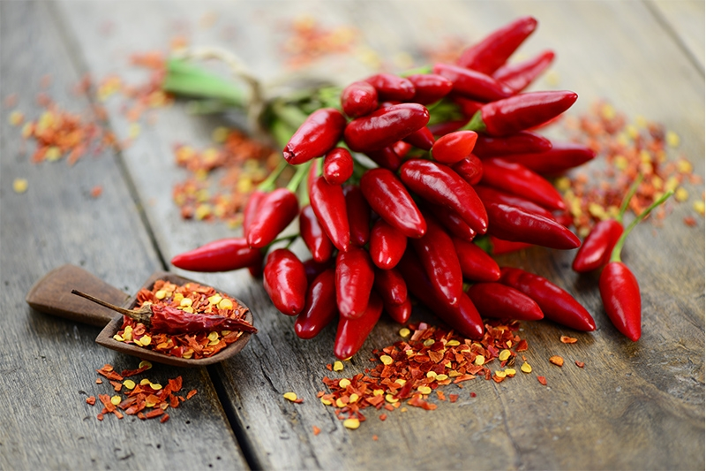
Lavoro di gruppo a cura della classe II C
Istituto omnicomprensivo statale Soriano Calabro
Scuola secondaria di I grado
“V. Tigani”
Sorianello

Slide 2
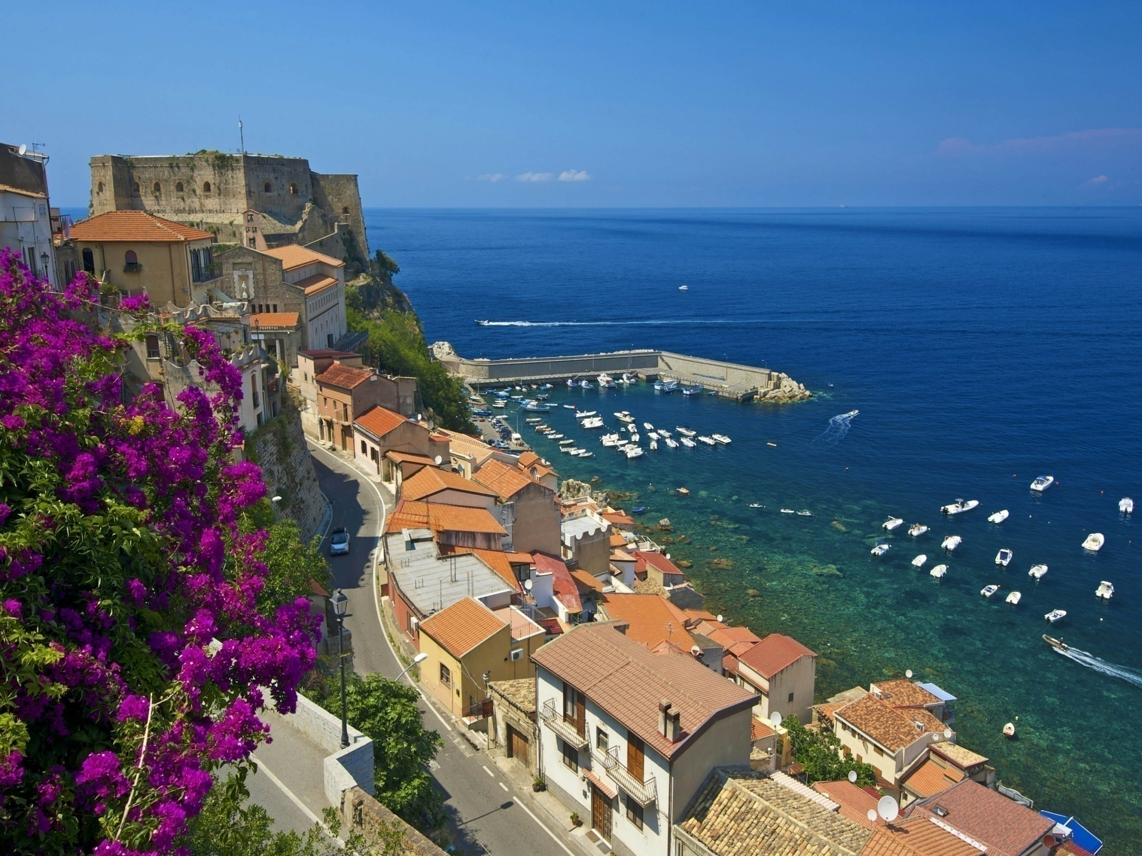
Calabria

Slide 3
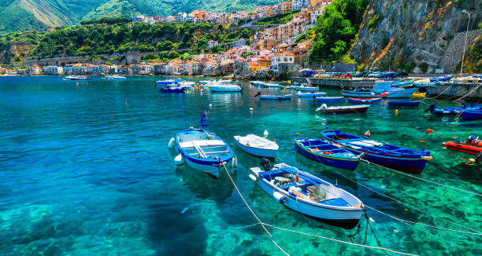
What is Calabria?
Calabria is a peninsula in the south of Italy. It borders with Basilicata, in the north, and it is bathed by Tirrenian and Ionian seas. The most important rivers are Crati, Mesima and Neto. The longest one is Crati, 91 kilometers . The mountain chains are Pollino, Sila,Serre and Aspromonte and the highest mountain is Serra Dolcedorme, in Pollino area.

Slide 4
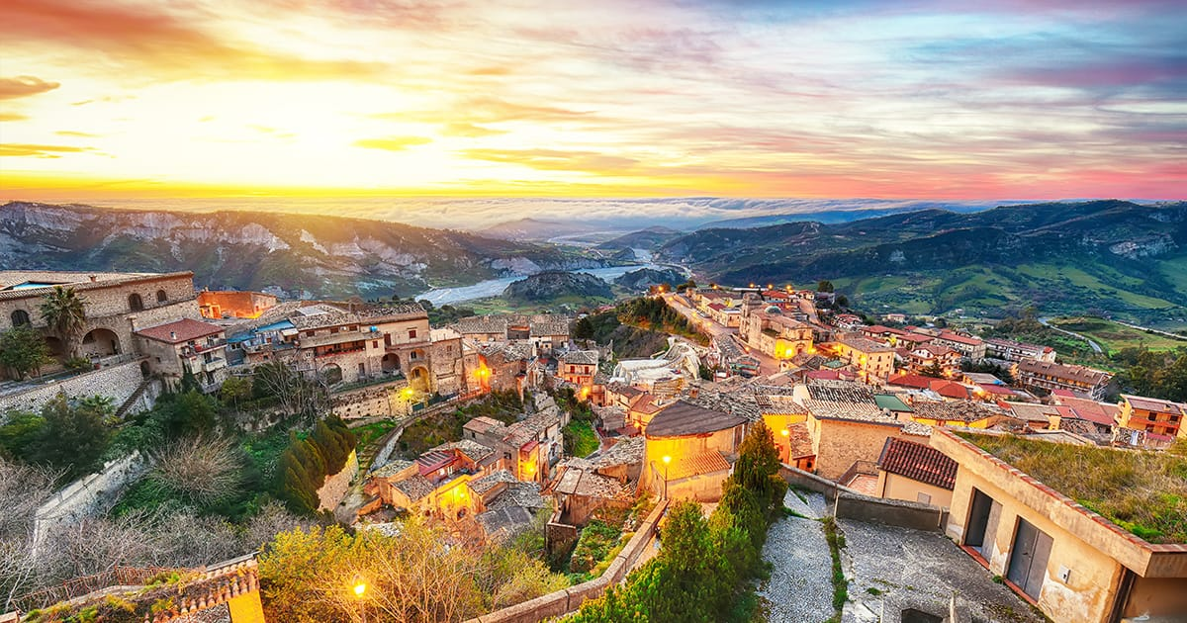
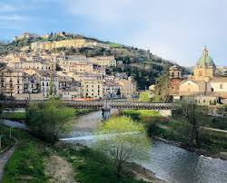
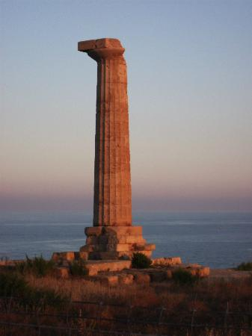
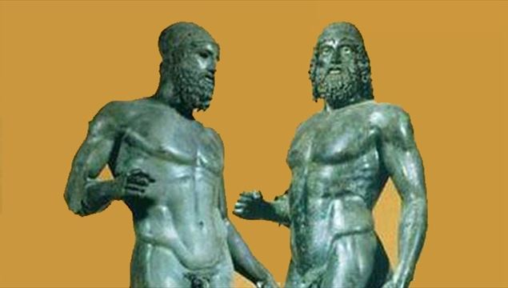
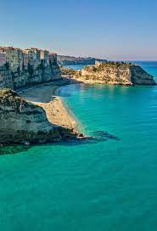
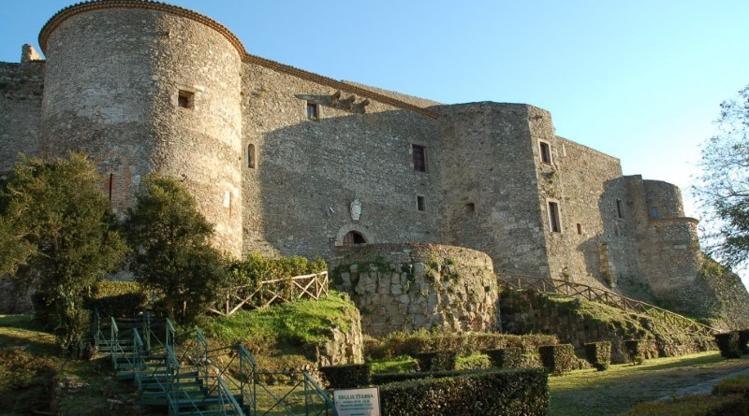
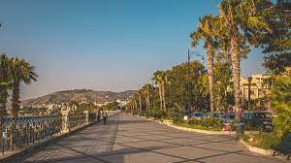
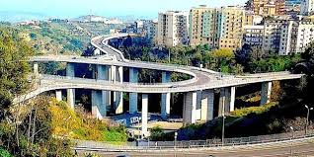
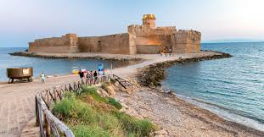
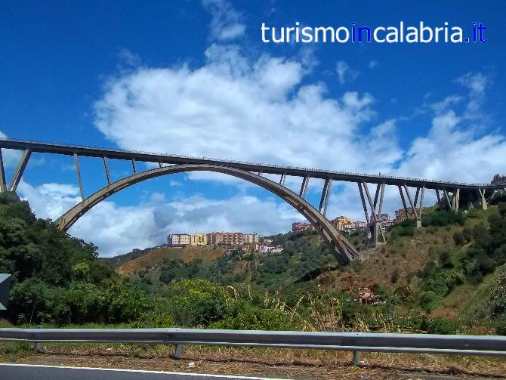
How many provinces are there in Calabria?
Calabria is divided into 4 provinces: Vibo Valentia, Cosenza, Crotone, Catanzaro and the metropolitan city of Reggio Calabria

Slide 5
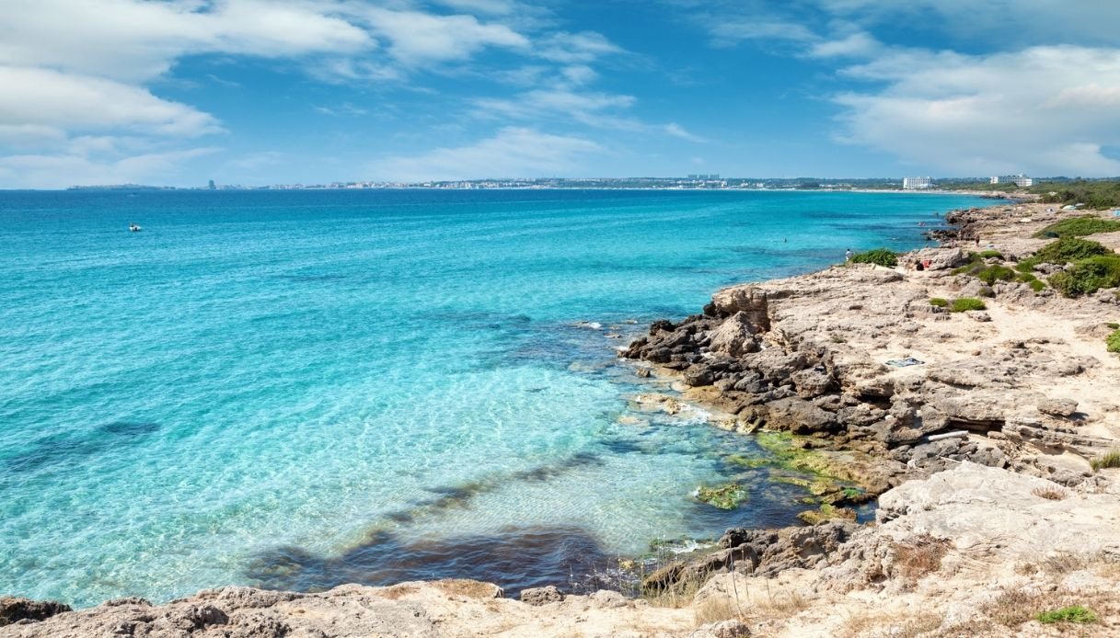
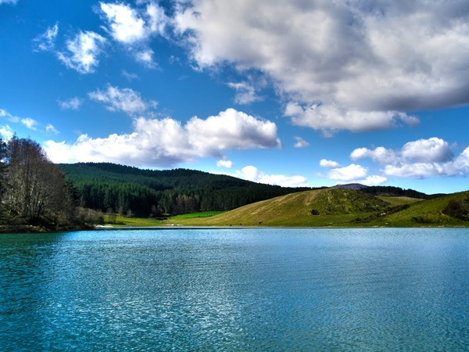
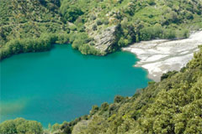
The lakes
Among the most beautiful lakes in Calabria, there are:Arvo,Angitola, Ampollino and Cecita. The largest is Ampollino and it is in Sila.

Slide 6
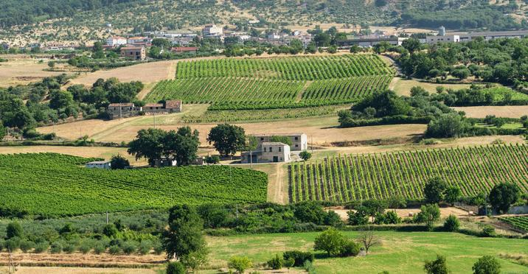
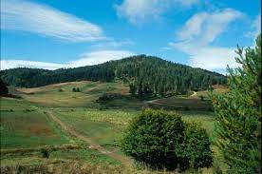
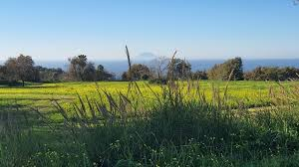
The plains
There are many plains in Calabria:Piana di Scalea; Piana di Sibari,
Marchesato di Crotone,Piana di Sant'Eufemia, Piana di Palmi and Piana di Locri.

Slide 7
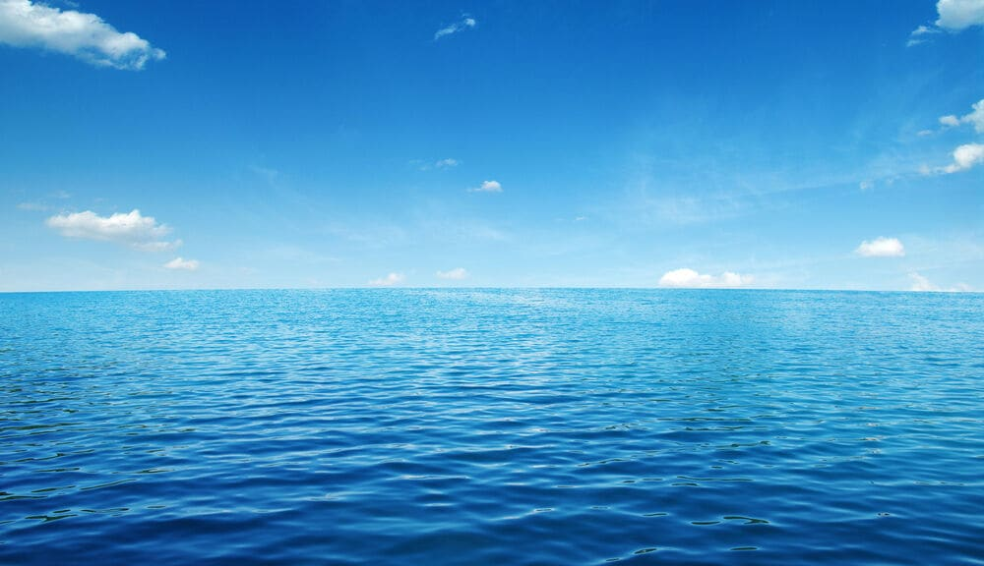
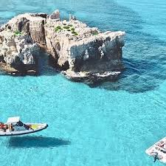
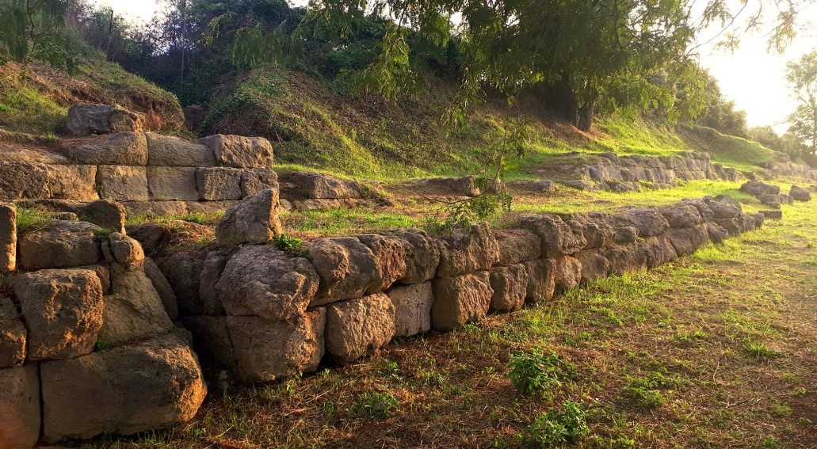
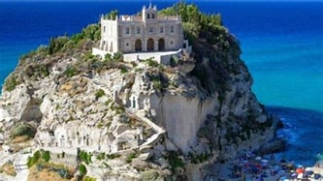
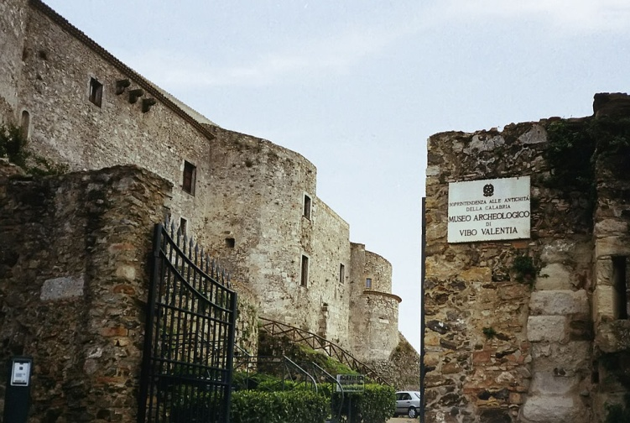
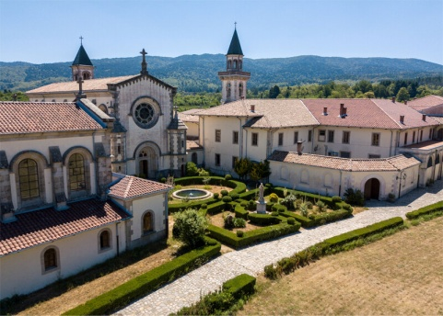
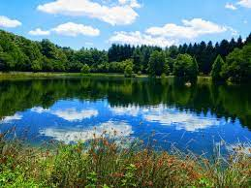
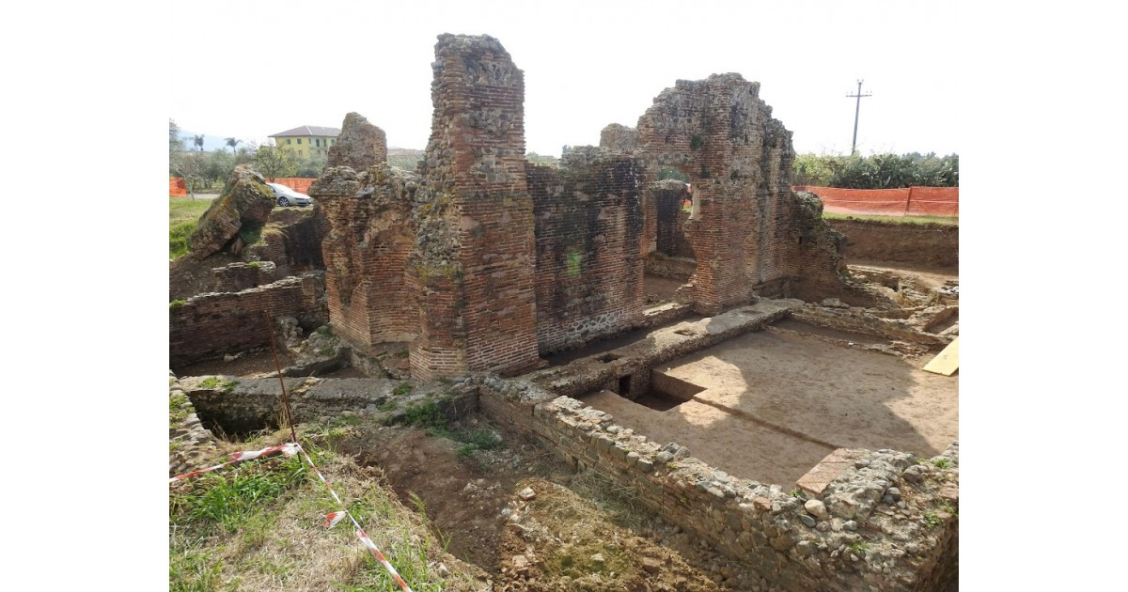
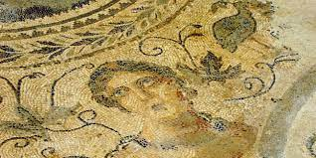
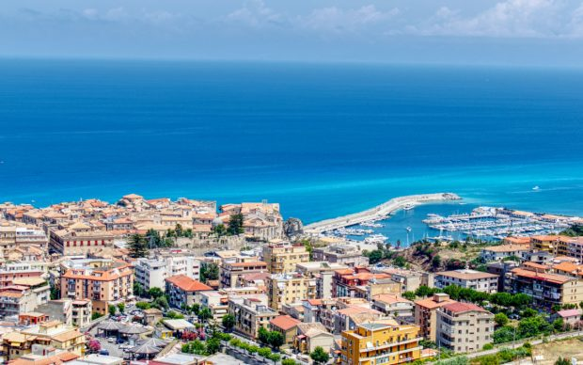
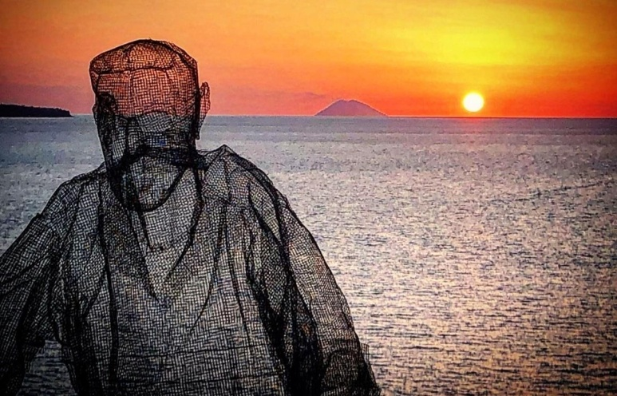
Our area
Our province is Vibo Valentia in the central part of Calabria. Vibo has got 33,000 inhabitants. Its old name was Monteleone and before Hipponion when it was a Greek colony. This province is made up of 40 municipalities. The highest mountain in this area is Monte Pecoraro and the most important river is Mesima. Turism is very developedi in some places such as Tropea, Capo Vaticano and Pizzo for the beautiful beaches and Serra San Bruno and Mongiana for the magnificent forests.

Slide 8
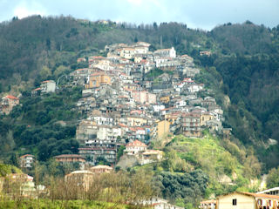
Sorianello, our village
Sorianello is on a hill between Soriano Calabro and Serra San Bruno. About 1,000 inhabitants live here. There are 5 churches which are: Santa Maria del Soccorso, San Giovanni Battista, San Nicola alla Bastia, the small church of San Bruno and the most recent Cristo Redentore in the district of Savini. There is an affluent of Mesima, Cornacchia, which runs in “Valle dei Mulini”.

